Slide 1

Understanding barriers to adoption of Rhinopinch within the NHS
Prepared for:
By Creative Medical Research
May 2013

Slide 2
Contents
Executive summary 3
Background and methodology 6
Existing practice 9
Reactions to Rhinopinch 18
Decision making 25
Conclusions 31
Recommendations 37

Slide 3
Executive summary

Slide 4
Executive summary (I)
SHIL commissioned CMR to investigate barriers existing to the adoption of Rhinopinch, a disposable plastic nasal clip designed to staunch nosebleeds, where uptake within the public sector has been relatively poor. 10 telephone interviews were conducted with consultants working within Emergency Departments, 2 of which had previous clinical experience with the product.
The research highlighted an average of 4 epistaxis cases in A&E per day, ranging from 3-4 a week in smaller general hospitals to 10-12 a day in large teaching hospitals. Most patients tend to be elderly, often more at risk due to hypertension and anti-coagulant medication.
Most epistaxis cases require a manual pinch, although often performed incorrectly by the patient before demonstration by an HCP. If bleeding still uncontrolled and cannot be cauterised there is a need for packing, committing the patient to an ENT admission for further monitoring.
Rhinopinch was viewed as a direct alternative to the manual pinch, with the immediate benefit of providing correct pressure in the correct position, for a sustained time period, hence removing responsibility from the patient and increasing HCP peace of mind.
There is the potential to save some (although not considered substantial) HCP time in patients who cannot pinch their own nose (e.g. elderly with arthritis, dementia and without a family member or carer). However, a more motivating argument for Rhinopinch and one likely to justify its price, is the link which all but 3 HCPs make of a better pinch resulting in reduced need for further intervention. Reducing the need for packing could have direct cost savings regarding the packing procedure itself but also on-costs relating to patient admission.

Slide 5
Executive summary (II)
Although an obvious barrier is convincing HCPs to switch from the free technique of the manual pinch, the majority are convinced Rhinopinch would be able to demonstrate such benefit.
All but one HCP would be willing to try Rhinopinch at its existing price. Clinical evidence is not required; HCPs would conduct internal audits during a short trial phase and would expect results to demonstrate the cost savings outlined above. It is assumed there would not be resistance from departmental budget holders (the product is unlikely to go through central procurement given relatively low unit cost).
Given the interest and perceived benefits from the HCPs involved in the research the key barrier currently existing is product awareness. HCPs consider direct contact with the Emergency Departments, providing free samples and product demonstrations to be the best approach.
SHIL could consider collating audit results from hospital trials and promoting long term economic benefits of Rhinopinch at conferences such as the College of Emergency Medicine where a wider audience could be accessed.
If it is unable to be demonstrated that Rhinopinch can reduce significant on-costs associated with packing there is still a market for the product, albeit smaller and more niche in those who are unable to perform a manual pinch themselves – however this is potentially more difficult to justify purchase at existing prices. SHIL could consider actively pursuing other areas that the research highlighted, including first aid within schools and selling to pharmacies for home use I patients with recurrent epistaxis, however branding may need to be considered if marketing to the lay person.

Slide 6
Background & methodology

Slide 7
Background & objectives
Background
Scottish Health Innovations Ltd (SHIL) works in partnership with NHS Scotland to protect and develop new innovations that come from healthcare professionals. One such product is Rhinopinch, a lightweight, disposable plastic nasal clip designed to staunch nosebleeds by fitting onto the nose and applying adequate pressure to halt blood flow.
Uptake of Rhinopinch has been very positive within the private sector, especially within the geriatric market. Despite fitting with the protocol of treating nose bleeds, being disposable in nature and simple to use, uptake within the public sector has been relatively poor.
SHIL requires market research to explore the key barriers to adoption of Rhinopinch within the NHS.
Objectives
The key objective is to understand how SHIL can increase the use of Rhinopinch within the NHS, with specific focus on:
Potential applications and need for the device
Potential barriers to uptake and how these may be overcome
Understanding the decision making process for the adoption of devices of this nature

Slide 8


Methodology & Sample
Country
Methodology | 10 x 45 minute teledepth interviews with consultants involved in emergency medicine A product sample was sent to each participant prior to interview
Final sample | 5 x Emergency Medicine Consultants (1 user) | 4 x Emergency Medicine Consultants (1 user) 1 x Paediatrician (split practice with acute admissions)
Screening requirements | Users: to have had exposure to and personal experience of using Rhinopinch in clinical practice Non-users: no previous experience of using Rhinopinch All to be spending majority of practice within A&E department
Date | March - April 2013
Note: findings in this report are based on 10 participants only and may not necessarily be reflective of the wider population

Slide 9
Existing practice: management of nosebleeds

Slide 10
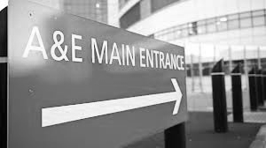
HCPs involved in the research estimate their Emergency Department sees on average 4 epistaxis cases per day, with elderly patients representing the majority
On average, HCPs estimate their Emergency Department to be seeing 4 epistaxis cases per day; ranging from 3-4 a week to 10-12 cases a day in larger teaching hospitals
The majority are walk in cases, generally presenting only for the treatment and management of their nosebleed
Majority of epistaxis patients presenting in A&E are elderly
At increased risk of epistaxis often due to:
Over 60 years old
High blood pressure / hypertension
Exposure to antiplatelets or anticoagulants (e.g. Warfarin)
Most of the epistaxis cases are considered spontaneous; only a minority are due to trauma (e.g. assault, sporting injury)
Paediatrics are also a risk group for epistaxis but not seen in A&E as frequently as elderly
More likely to be suffering from spontaneous anterior epistaxis
Often caused by picking
Not all A&E depts. involved in the research see paediatric patients
Types of epistaxis patients presenting
Other small patient subsets more at risk of epistaxis are:
Platelet and blood clotting disorders (e.g. haemophilia)
Patients undergoing cancer treatment (e.g. bone marrow suppression)

Slide 11
No official classification system exists for epistaxis but HCPs generally look for factors that are likely to dictate whether bleed is anterior or posterior, which may affect course of management
HCPs are not aware of a classification system for epistaxis but do tend to look for key observations or risk factors which may impact on treatment approach
Risk factors
Patient history: taking medication or have condition making them more predisposed
Age: elderly more likely to have posterior bleed, younger anterior
Observations
Anterior versus posterior bleed
Anterior most common (70%) with bleed at front (visible) versus posterior bleed at back of nose (non-visible)
Duration of bleed: e.g. first in episode or recurrent
Severe (rapid flow / ‘hosing’) versus trickle: elderly tend to be more severe
Cause
Trauma induced versus spontaneous (majority will be spontaneous)
Most commonly, HCPs classify epistaxis on where the bleed is coming from: anterior or posterior.
However, given that this may not be obvious upon initial presentation, generally all epistaxis patients are approached in a similar way until it is possible to see where the bleed is coming from
"When you see a patient you don’t 100% know whether its anterior or posterior so you end up approaching all patients in the same way.”
- Consultant, Scotland

Slide 12
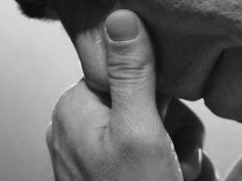
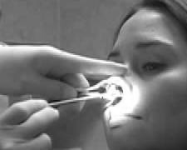
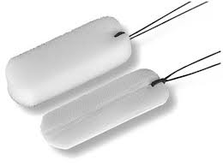
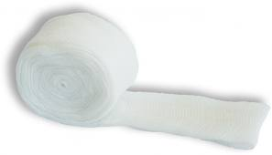

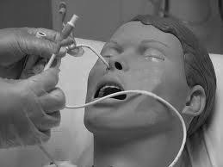
HCPs are unaware of any official guidelines set by scientific bodies; only half follow a written departmental protocol, however generally a consistent approach will be taken
Patient presents
Majority of epistaxis patients
Minority of epistaxis patients
A minority proceeding straight to packing if HCP deems pinching waste of time (gushing bleed, likely posterior, past history, can trust patient has tried pinching properly, repeatedly)
First step is almost always manual nose pinching
15-20 min (majority)
3 x 10 min (1 mention)
Manual pinch
Visible bleed site
No visible/multiple bleed sites
Proceed to packing (esp. in elderly) if:
Pinching unsuccessful
Heavy bleeding / gushing
Bleed point not visible (likely posterior bleed)
Multiple bleed sites
Commonly either nasal tampon (Merocel) or Rapid Rhino used. Ribbon gauze only used by 1 HCP who also had choice of the other two methods. Patient referred to ENT after packing
Packing
Cautery
Nasal tampon
Ribbon gauze
Rapid Rhino
Cautery with silver nitrate if bleed point visible (anterior epistaxis) and bleeding stopped / subsided. Patient monitored then discharged
In very rare cases (usually trauma) resort to Foley catheter and balloon if packing unsuccessful. Patient referred to ENT
Foley catheter

Slide 13

Pinching is the first method employed for the majority of epistaxis and is demonstrated by an HCP who then leaves the patient (if possible) to be assessed 15-20 minutes later
Pinching is often already attempted by patient prior to presentation
Demonstrated to the patient by an HCP - usually nurse, healthcare assistant or junior doctor; patients encouraged where possible to pinch their own nose
Ice may also be applied in conjunction (1 mention)
Ineffective for posterior epistaxis or profuse bleeding (e.g. 2 HCPs comment 80%-90% will proceed to packing)
Frequently performed incorrectly by patients before being properly educated; don’t apply pressure for long enough, or press hard rather than soft part of nose
Difficult for elderly to grip hard enough for long enough due to frailness or arthritis
HCP required to pinch if patient unable and no relative/carer, however generally considered infrequent (max. 1-2 times/day)
Difficult to teach technique to some, especially elderly who are more likely to become confused or panic due to blood
Effective for spontaneous anterior epistaxis if done properly
Educational tool for patients; may prevent readmission in patients with reoccurring epistaxis
Can be done anywhere
Easy to do; usually patient or family member/carer can do it
Free - doesn’t require any equipment
“In simple nosebleeds that aren't bleeding profusely then it tends to be very successful.” - Consultant, Scotland
“If they're particularly frail then they wont be able to pinch hard enough for long enough…as a last resort one of us will sit there and pinch their nose for them but obviously that takes us off the shop floor completely.” - Consultant, Scotland
"When we ask the patient where exactly did they pinch, they will tell us they've put their finger on the bone...the concept of pinching the soft part of the nose is still not very clear among patients and this is a common frustration.“ - Consultant, England
“We're teaching someone who often gets nosebleeds how they can first aid manage these and may well prevent them having to come into the hospital.” - Consultant, England

Slide 14
Cautery with silver nitrate is performed when the bleeding vessel is visible (anterior bleed only); it is generally considered quick and effective in these cases
Silver nitrate is applied to coagulate the blood
Generally done by Emergency specialists, however 2 HCPs that it is performed by ENT specialists who are called in to perform
Suitable when bleed point visible, usually done when bleeding stopped or small amount of bleeding (not profusely); however epistaxis with multiple bleed sites or posterior bleeding are not candidates for cautery
Effective for single anterior bleed
Can prevent subsequent A&E admissions
Actual procedure is very quick (matter of seconds)
Simple procedure (but does require training)
Patient can be discharged after short period of monitoring
Unsuitable for posterior bleeds; have to have visible bleed site
Requires equipment including headlamp / torch and suction which can be time consuming to source
Performed by doctor (or sometimes junior doctor)
Can be uncomfortable for patient despite initial spray with anaesthetic
Risk knocking off clot already formed and restarting bleed
Overuse can cause necrosis of septum
“I'll have a look up the nose even if the bleeding has stopped. Because its pretty common that people get several days of nosebleeds and they'll re-attend, which just creates extra work for us. So if I look up and see where the bleeding has been or where it has come from I can cauterise around that area.“ - Consultant, Scotland
“It’s time consuming, you need to have decent kit, you need to have a decent headlight….nice suction…in the past we had units to be set up with all of that stuff and now we just don't seem to be..." - Consultant, England
"It can be quite uncomfortable even if you try to use some local anaesthetic.“ - Consultant, Scotland

Slide 15

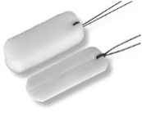

If pinching unsuccessful and cautery not possible, HCPs proceed to packing which can involve use of nasal tampons, Rapid Rhino or ribbon gauze
Packing is performed if pinching is unsuccessful and there is no visible bleed site, or multiple bleed sites. If the nose is severely gushing, cautery will be unsuccessful; in these very severe cases HCPs may even skip the pinching phase.
Patients proceeding to packing most likely have a posterior bleed, and is more likely if the patient is elderly and on anticoagulants. Packing is also used in severe anterior epistaxis.
“If it is pouring down blood, and if you think the bleeding is coming higher up and you cannot see any area of the nose where you can pinpoint this is the blood vessel that is oozing blood, what we do is use a nasal tampon.” - Consultant, England
PACKING OPTIONS | USAGE
Nasal tampon (Merocel) only: Compressed foam that expands and puts pressure on the area | 3 Scotland / 3 England
Rapid Rhino only: Tampon with balloon that inflates and promotes clot formation | 2 England / 1 Scotland
Both options plus ribbon gauze available: | 1 Scotland
Although different methods of packing are being employed, most departments have just 1 available; either nasal tampon (Merocel) or Rapid Rhino
Only one HCP involved in the research had a choice of Merocel, Rapid Rhino or ribbon gauze

Slide 16
Regardless of which method is adopted, packing commits the patient to an ENT referral which can mean the patient is admitted for up to 24 hours
Packing of a patient commits them to an ENT referral due to:
Monitoring required due to restricted airways
Primary Care not experienced in inserting and removing packing
Risk of removing clot when removing pack and hence causing re-bleed
Risk of infection
More treatment may be required if packing unsuccessful (within the ENT department)
Length of stay once referred to ENT is generally unknown among the A&E consultants; could be as an outpatient or may involve an overnight stay (depending on time of day). Patients are expected to be admitted for a minimum of 6 hours
“Once we've packed the nose, they are automatically referred to ENT…they go to the ENT ward and its up to the ENT ward…it is best to observe over night then they are discharged the next day.“ - Consultant, England
Due to the need to refer to ENT, HCPs admit to only packing the nose when deemed completely appropriate, as recognise the costs and time associated:
“As a general rule, if a patient requires their nose to be packed, then we wouldn’t discharge them from the emergency department….we try and avoid admission if its possible and appropriate.” - Consultant, Scotland
“We don’t want to pack the nose, because when you pack the nose you're committed to admitting the patient, although some of the ENT departments I see now are managing patients as an outpatient with nasal packing." - Consultant, Scotland

Slide 17


All methods have their drawbacks, however generally Rapid Rhino is considered the most effective method of packing, although also the most costly
Nasal tampon
Rapid Rhino
Ribbon gauze
Different lengths available for different nose sizes and types of bleed
Quick procedure if inserted properly
Cheaper than Rapid Rhino
More comfortable than gauze
Considered very effective (more so than nasal tampon)
More innovative than tampon
‘Enjoyable’ technique to learn for junior doctors
Can be more comfortable than nasal tampon
Easier to insert in small noses
Results in ENT referral
Requires a doctor to insert
Expensive
Can be uncomfortable for patient
Need to find time and space to do procedure; takes 5-10 mins
Results in ENT referral
Requires a doctor to insert
Doesn’t always stop bleeding, just stems it; not considered as effective as other packing methods
‘Old’ method
Results in ENT referral
Requires a doctor to insert
Not as effective as Rapid Rhino
Coarse material uncomfortable for patient
Difficult for very small noses
Requires training to insert
May need to pack both sides as doing one not always effective
‘Old’ method
“The nasal tampons can be quite uncomfortable for the patient sometimes. If they have small noses and small nasal flares then it can be difficult to insert that. Sometimes it can be easier to gently insert the gauze.“ - Consultant, Scotland
“[Rapid Rhinos are] very effective. We probably find that 80-90% of our patients will have adequate control.“ - Consultant, England
“We’ve now moved to the balloons… [tampons are] old tech…before balloons, before tampons we had to pack noses with a ribbon of gauze. Its not done now.” - Consultant, Scotland

Slide 18
Reactions to Rhinopinch

Slide 19
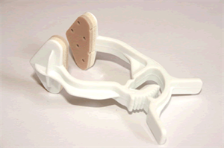
HCPs reacted very positively to Rhinopinch with the immediate benefit seen as ensuring the pinch is done in the right place with the correct pressure for an adequate length of time
Rhinopinch takes responsibility away from the patient hence giving HCP peace of mind that the technique is done adequately; there is also scope to free up HCP time in the instances where they are required to do the pinching on behalf of the patient
Consistent pressure in correct position gives peace of mind that the pinch has been done properly
Reduces reliance on patients who frequently perform the pinch incorrectly and for too short a time period
Reduces need for HCP to assist those who cannot pinch their own nose (e.g. frail elderly, arthritic) hence potentially time saving to the department
Simple to use and unlikely to require training
Lightweight so comfortable (ensuring greater compliance)
Frees up patient hands which could be useful for IV access
May prevent intervention with packing if can stop bleeding more effectively than manual pinch (MIXED REACTIONS)
May proceed to cautery more quickly if can stop bleeding more effectively than manual pinch thereby reducing patient time in Emergency Department (1 MENTION ONLY)
“I thought it was a very good device. Its nice and simple and lightweight, and for those people who find the pinching of their nose difficult, either they have arthritic hands or they find complying with it difficult, then this is a nice easy way...you slip it on, tell them not to touch it, then you can walk away from them for ten minutes and know that its going to be pinching reasonably well.” - Consultant (User), Scotland
“Ten minutes is a very long time when sitting in the A&E department. It looks like ten hours, so they have the tendency to take their hands off then watch for the bleed then insert tissue into the nose. Whereas if this clip is applied, at least we can be reassured that there is constant pressure on the nose for a good ten minutes.” - Consultant, Scotland

Slide 20
Despite a mostly positive reaction there were some concerns around the device coming off and the ratchet mechanism. There was also a small concern that the triangular pads may miss the bleed point
Most concerns centre around the device being removed or being knocked off, however HCPs note that this is less of a concern than a patient not being able to effectively pinch their own nose manually
“The only thing I'm not sure about is how well it maintains the pressure for that length of time....whether it would stay in place and maintain pressure.” - Consultant, England
Risk of patient removing it or getting knocked off (BUT CONSIDERED LESS RISKY THAN PATIENT INCORRECTLY PERFORMING MANUAL PINCH)
Ratchet mechanism does not look very robust; fear of breaking
Risk of small triangular pads missing the bleed point (manual pinch thought to cover a wider area)
Must not negate need for patient education; patients likely to have recurrent bleeds so will need to know how to do a manual pinch
Ratchet mechanism not overly straight forward (some query over whether it is applied closed or open)
Concern that it is too big for very small children
Costs money unlike the manual pinch
Cannot use easily with ice pack (1 MENTION ONLY)
“My concern mainly is that it might get knocked off or knocked out of position…but its more likely they'd take their hand off [when manually pinching] than this will get knocked.” - Consultant, England
“I wonder whether because its slightly smaller than the thumb and the finger if you get it in just the wrong place and just miss the bleed point, then it wouldn’t be effective, whereas with your thumb and your finger you're covering a wider area....its a game of odds...if you cover as wide an area as possible you're more likely to stop the bleeding.” – Consultant (User), Scotland

Slide 21
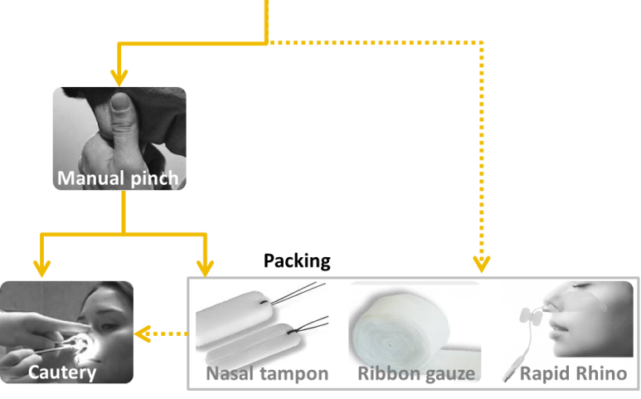
Rhinopinch is viewed as a direct alternative to a manual pinch; with the immediate benefit of saving HCP time if a patient cannot perform a manual pinch themselves
HCPs perceive Rhinopinch as a direct alternative to manual pinching and hence only applicable for patients who require pinching (not the minority proceed to packing immediately). The benefit in this patient cohort is considered to be:
"everyone is receiving the rhinoclip, if we've got them. Sometimes if stores are low then they wont have one, but the plan is that everyone would have one."
for patients who cannot do adequate manual pinch
= removes need for HCP to step in
= saves HCP time
However, views are mixed as to whether Rhinopinch would be employed in all candidates for pinching, or just those who cannot perform a manual pinch:
vs.
Only patients who cannot pinch their own
(2 Scottish including 1 existing user)
Will free up HCP time in dealing with patients who cannot do it themselves (elderly, dementia, disabled)
Manual pinch is free and most patients are capable
Will need to educate all patients how to do a manual pinch anyway as most will suffer from recurrent epistaxis
Any patient requiring a nasal pinch
(5 English including 1 existing user / 2 Scottish)
Would help elderly most, BUT many patients frequently struggle to perform pinch reliably without being shown how
Will give peace of mind to HCP and improve patient adherence
Could provide further benefit of preventing intervention
“I'm not using it terribly frequently myself…if you can get a patient to pinch with their fingers then they'll know what to do next time they get a nosebleed, so tend to see if I can get them to pinch first, but if its just not happening, then I'll proceed to using the Rhinopinch.“ – Consultant (User), Scotland
“As soon as the patient arrives, we could apply one of these…what people usually do is they do it for a couple of minutes then remove their hand because their hand is uncomfortable...we know this will be kept on continuously, and sustained.“ - Consultant, England

Slide 22
Rhinopinch is not considered a replacement for cautery or packing, however most anticipate it reducing the need for packing, which could have motivating long term economic implications and justify cost
Most HCPs make an immediate link between Rhinopinch offering a more effective pinch than manual pinching and hence preventing the further chain of intervention:
“I'm sure its going to be more effective [than grasping with hand] because it’s a continuous, sustained pressure over the right area. I'd be surprised if it wasn't more effective.” - Consultant, England
Consistent pressure in correct position for adequate time period
= more effective pinch
= more likely to stop bleed
= less likely to proceed to packing
= LONGER TERM COST SAVINGS
“If I've got a patient who is holding their nose and they might not be doing a good job and the nurse says its still bleeding...I'll put some Rapid Rhino up your nose…takes a few minutes to do that, find a place to do it, get the equipment, do it…the time I've spent, if this thing works better than the patient's pinch, would have been completely saved.” - Consultant, England
Reducing packing has benefits that could easily justify the price of Rhinopinch:
PACKING PROCEDURE
Price of nasal tampon (few pounds?) or Rapid Rhino (estimates vary £100)
Doctor involvement (lapse in concentration / called away from potentially more urgent cases)
Use of a cubicle
ENT REFERRAL
Cost of cannula/equipment for checking blood
Blood samples sent to lab for clotting
Monitoring by ENT department
Admission: potential over night stay / use of bed
“If my experience was that it did this well, and I started to get personal experience of success or there was some research to show the rate of packing decreased…the saving you're talking about is not going to be the time to squeeze someone's nose. The saving that will convince me massively, clinically, would be if this decreased my rate of packing and therefore my ENT referrals.” - Consultant, England

Slide 23
However, whilst many make the connection that Rhinopinch could reduce packing, others are adamant that Rhinopinch would not affect further intervention, hence feel price may not be justifiable
Not every HCP is convinced by the premise that a more effective pinch will stop the further chain of intervention. 3 HCPs (Scottish) believe that patients who need packing will need packing regardless of whether manual or Rhinopinch employed (e.g. they may have posterior bleed, or heavy flow that will not be stopped by pinching alone, regardless of method)
“It would replace manual pressure. I don’t think that if a patient requires cauterisation or packing that its going to prevent these procedures from taking place, because I think it’s a different type of patient who is not going to benefit from manual or 'clipped' pressure alone.” - Consultant, Scotland
“This Rhinopinch is aimed at someone before they get to this stage, its not an alternative to the balloon up the nose….I put a balloon up the nose when pressure doesn’t work.” - Consultant, Scotland
"I don’t foresee evidence ever coming to life that this prevents hospital admissions in patients with simple anterior epistaxis.”
- Consultant, Scotland
2 HCPs (Scotland) consider cost unreasonable but only 1 would not consider purchasing at all based on cost
Saving HCP time when patients cannot perform a manual pinch themselves is still considered a benefit, however not enough of a quantifiable benefit by itself, given that this is considered to occur infrequently (max. 1 per day) and healthcare assistants are usually available or junior staff willing to learn
Assumed would cost <30p per item
Expensive given materials and likely production cost
Too expensive to justify given perceived lack of long term cost saving unless priced at less than £1 each (1 mention)
"I think that would be too expensive…because its not offering anything unique. Its not offering anything that’s currently free, and I don’t think its going to prevent admissions in patients that we see currently...I couldn't justify that cost for what it is based on our current practice.” - Consultant, Scotland

Slide 24
Given the simplicity of the product and the fact that the majority expect it to be as effective if not superior to manual pinching, few barriers exist to uptake
Competition | HCPs are not aware of a similar product however the direct competitor is the manual pinch which does not cost anything (hence some will only consider RP for patients who cannot pinch manually) 2 HCPs note that staff enjoy using Rapid Rhino and junior doctors are able to achieve credits for using interventions (cautery, packing) but not pinching (or Rhinopinch) hence could present barrier
Awareness | HCPs must see Rhinopinch in use to have it top of mind Shifting behaviour and encouraging the adoption of a new technique always presents a barrier however, most HCPs feel confident potential benefits will overcome this
Training | Staff training not considered necessary given such a simple product but some feel a company rep should come in and demonstrate the product to build relationship so that HCPs have a company contact in case of problems
Storage | Generally not expected to be an issue, especially if the use of Rapid Rhino decreased
Guidelines | Not all Emergency Departments have official guidelines for epistaxis; those who do would update their internal guidelines to include Rhinopinch; not considered a barrier
Patient education | Rhinopinch does not negate need for education; HCPs will still teach patients how to do a manual pinch, especially as the patients presenting in A&E are likely to suffer from recurrent nose bleeds
NHS supply chain | Not all are even aware of the website; not considered to impact the end user
“The doctors enjoy doing it [inserting Rapid Rhino]…its very simple and its a procedure they like to learn. A lot of their log books contain “ done procedures XYZ" and nasal packing is one of the simple procedures they can get credit for doing...pinching the patients nose isn't one of these procedures.” - Consultant, England
“Initially it wont be used in all of them, but once they start using it, and people walk past patients who are having it and see it can be used and they learn how to use it, they will begin to use it where self-pinching would have done the job, without even trying it.” - Consultant, England

Slide 25
Decision making

Slide 26
All but one HCP would be willing to try Rhinopinch at the existing price and without further evidence of efficacy
Despite the mixed views as to exactly how many patients would be applicable for Rhinopinch, all but one HCP (Scotland) would be willing to try the product at the existing price point
How many required in the department depends on whether the HCPs see a use in all patients presenting who require a manual pinch, or just the niche group who require an HCP to do the manual pinch for them
For the majority:
All epistaxis patients requiring pinching:
Avg. 4/day = 28/week = 112/month
1 HCP (user) will also give the patient a new product to take home in case of further bleed
For the minority (2 HCPs):
Patients who cannot pinch their own nose:
Avg. 6/week = 24/month
Some form of cost benefit data would be motivating in the form of a randomised trial which demonstrated out of those who received Rhinopinch versus manual pinch, how much HCP time it saved and whether the patient proceeded to packing
However, given the simplicity of the product and the expectation of a more effective pinch, HCPs would be happy to trial the product and conduct their own internal audit
All but one HCP (Scotland) expect a trial to provide positive results in terms of long term economic savings
“If I audit it I'd find out patients' satisfaction, nurses' satisfaction, and physicians' satisfaction…then we'd say OK, you had the nose pinch for 10 minutes, check the nose, any bleed? Yes / No. …Cautery. Yes / No. Anything after cautery? Yes / No? Is it still bleeding, did they have a pack? Yes / No? ...We know the chain anyway - so we can cut down the chain if we apply a proper pinch.” - Consultant, England

Slide 27
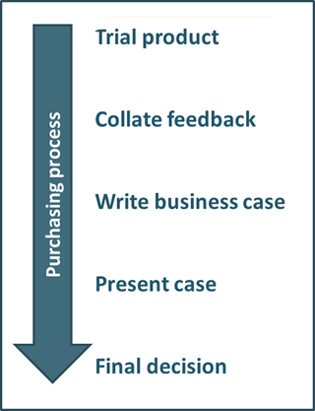
HCPs would conduct an initial trial for 4-6 weeks to test the product and conduct an internal audit for use in a business case
All HCPs state they would require a trial period to test Rhinopinch
Avg. 4-6 weeks trial required (in larger hospitals may only need a week given higher numbers of epistaxis)
Most agree funds could easily be obtained from the department for trial, but 2 HCPs would expect free samples for trial duration
An internal audit would be performed during the trial:
Does Rhinopinch save HCP time? Does it lead to shorter stay in Emergency Department?
Does it work better than pinching?
Does it prevent interventions (packing)? And hence ENT referral
What do nurses and consultant colleagues think of the product?
Are there any objections from ENT colleagues?
What do patients think? 1 HCP (England) would ask patients to complete a satisfaction survey
“A really low cost product like this - for a trial, would be easy. If we were then going to go towards this as a full time purchase, then it would just be a case of getting a bit of data about how many times we're likely to use it, what’s our potential annual saving going to be and writing a relatively short business case about it.“ - Consultant, England
“If it was brand new to the department, then I image you'd want to ask Ear, Nose and Throat what they thought about it, because obviously if they're dead set against it…you're gonna want to speak to the specialists. You might take their advice, you might not...it would be a sensible thing to ask.” – Consultant (user), Scotland

Slide 28
HCPs expect the case to outline reduced HCP time and/or use of other interventions and hence demonstrate a long term benefit to including Rhinopinch in the departmental budget
Consultants would be responsible for compiling a short business case outlining the results from the trial, to include
Product benefit (e.g. reduced HCP time, reduced use of Rapid Rhino) and long term cost saving
Consultant and nurse advocacy
Patient feedback
The business case in most cases would only go to departmental budget holders who would give final go ahead (‘Divisional Manager’, ‘Operations Manager’, Clinical Department Lead’, ‘Business Manager’)
Given the low cost of the product it is unlikely there would be a need to justify to central procurement; only one HCP said central procurement likely to be involved (England)
“It would be the clinical lead I think. At this cost price I don't think the manager is going to say anything...its not like its a big capital cost or its going to have significant on-going costs.” - Consultant, England
Reordering: usually a nurse within the department is responsible for maintaining stock and will be notified when stocks get low
Process considered straight forward once a product has been approved; 1 HCP mentions the Oracle system; each time a piece of kit gets used it is recorded therefore automatically alerts when stocks get low
1 user mentions sometimes there are availability issues if nurse has not noticed stocks getting low; could be helpful to have reminder in box
Due to no expiry on the product so could in theory bulk buy, providing storage not an issue

Slide 29


HCPs feel the best way to raise awareness of the product is through showcasing at relevant conferences, and direct contact with the department themselves
Free product samples: get in direct contact with emergency department staff and provide free samples to A&E staff for trial
Conferences: get a booth and demonstrate the product and raise awareness
College of Emergency Medicine annual conference
Trainee conferences including trauma courses (ATLS)
Other annual A&E scientific meetings
Direct mail: HCPs suggest they often receive industry email summaries from companies with general articles relevant to A&E, or requests from companies to demonstrate their product
“Its just the way many reps do, they turn up and say ‘Here's ten, please play with them, please try them on a few people and see what you think.’ Its very common with a lot of products...I think people would use them and I think genuinely they might get some sales out of that.”
- Consultant, Scotland
“Probably the thing that would do it is if you sent our department some free samples, that would be the way to get people to know about it.“
- Consultant, Scotland

Slide 30
A&E is considered the biggest market for Rhinopinch but HCPs also suggest home use could be another key market; either through the hospital or via pharmacies
Most frequently mentioned
Situation | Need
Home use | Purchase from pharmacy or handed out in A&E to those pre-disposed to epistaxis (existing RP user hands out after cautery in case of re-bleed) Especially for children whose parents could employ it at night (1 mention)
Paramedics | Pre-hospital use so that nosebleed better controlled for arrival at A&E
Schools | Children pre-disposed to nose bleeds Usually spontaneous anterior bleeds that can be stopped with pressure only
Sporting events | For epistaxis caused by trauma
GPs | Some patients visit their GP with recurrent nosebleeds
ENT dpt | Generally don’t see acute cases of epistaxis or see very severe cases which are beyond the remit of Rhinopinch , however they could hand out for home use for those with recurrent epistaxis or may have a use for post op bleeding
Paediatric dpt | Paeds at risk of recurrent epistaxis, especially those with underlying conditions such as platelet and blood clotting disorders
Care of Elderly ward | Unsure of extent of need as assume staff would be available to sit with patient and do it for them
“The layman of the public are going to think 'rhino' as in the animal. I would have thought 'Nasal Pinch' would have been a bit easier, if you're ever going to sell it pre-hospital in the pharmacy. But its not terrible.” - Consultant, England
If Rhinopinch is to be marketed to the lay person branding may need to be reconsidered; currently appropriate for medical staff and ties nicely into ‘Rapid Rhino’ branding, however may need to add “nose pinch” or “nasal pinch” to packing to be clear for patients

Slide 31
Conclusions

Slide 32
Conclusions (I)
Research finding | Consideration for SHIL
A&E is considered to have the biggest need for Rhinopinch Emergency Departments see on avg. 4 epistaxis cases per day, more (10-12) in larger teaching hospitals Elderly patients represent the majority of epistaxis cases Other (lesser) markets were also highlighted and included paramedics, general first aid in schools and sporting events, and selling through pharmacies for home use in patients suffering from recurrent epistaxis | HCP feedback suggests that the current focus on the A&E sector is appropriate Large teaching hospitals represent the biggest market and are more likely to see potential for long term cost savings by using Rhinopinch due to high volume of cases Although alternative target sectors were highlighted their potential is limited

Slide 33
Conclusions (II)
Research finding | Consideration for SHIL
Most patients require pinching but it is usually performed incorrectly before being demonstrated by a HCP Small numbers (esp. elderly) are unable to do pinch themselves so a HCP must step in If still bleeding after pinching and cautery is not an option, the patient must proceed to packing Packing commits the patient to ENT admission | Greatest potential for Rhinopinch is seen to relate to: removal of the risk of the pinch being performed incorrectly replacing HCP involvement where patients cannot pinch their own nose possibility of negating the requirement for packing

Slide 34
Conclusions (III)
Research finding | Consideration for SHIL
Rhinopinch is considered a direct alternative to manual pinch It gives HCPs peace of mind that the pinch has been carried out properly and there is a perceived potential to save (some but not substantial amounts of) HCP time where patients cannot pinch themselves Most HCPs believe a more effective pinch will potentially reduce the need for packing However, not everyone links Rhinopinch to reducing further interventions | Rhinopinch is in direct competition with a technique that is perceived to be cost ‘free’ and a strong business case must be presented around HCP time However HCP time spent dealing with epistaxis cases is considered difficult to quantify given their infrequent nature Therefore SHIL will need to convince potential purchasers that saving HCP time in A&E provides sufficient cost benefit More motivating and likely to provide greater justification of the cost is the link that reducing packing would negate the need for patient admission and the significant associated on-costs; demonstrating this may be critical to success

Slide 35
Conclusions (IV)
Research finding | Consideration for SHIL
All but one HCP would be willing to try Rhinopinch at the existing price and they do not require evidence to do so However, long term adoption depends on the financial benefit of Rhinopinch being proven HCPs would likely conduct an internal audit during a 4-6 week trial phase, expecting to be able to demonstrate longer term cost savings as a result Considered likely that department budget holders would agree (unlikely to go through central procurement) | If a suitable business case can be developed existing cost is not expected to be a barrier and for most the procurement process is relatively straightforward compared to many products SHIL may be able to leverage HCP interest in order to develop a business case without significant investment

Slide 36
Conclusions (V)
Research finding | Consideration for SHIL
None of the non-users were previously aware of Rhinopinch HCPs suggested a need for free samples and direct contact with the Emergency departments Promotion at conferences such as the College of Emergency Medicine was also highlighted | Assuming a convincing business case, SHIL’s biggest challenge (and the critical barrier to adoption) will be raising product awareness Identifying the most appropriate channels for raising awareness is an important step, with free samples and promotion at relevant conferences critical

Slide 37
Recommendations

Slide 38

Recommendations
Raise awareness of Rhinopinch within the key market
All HCPs involved in the research were very receptive to Rhinopinch, with all but one willing to try the product at its existing price, therefore the biggest barrier to existing use is lack of product awareness. Consider raising awareness by providing demonstrations and free samples through:
Direct contact with Emergency Departments
Stands at relevant conferences (e.g. College of Emergency Medicine)
Collate convincing evidence for Rhinopinch
If it could be demonstrated that Rhinopinch can reduce packing and hence lower admissions to ENT thus negating significant on-costs, this would form the basis of a convincing business case
Consider collating audit results from several hospitals willing to trial the product (ideally large teaching hospitals that are going to be more influential and have higher epistaxis numbers)
SHIL may need to consider providing free samples for the duration of the trial period in return for hospitals providing data
At a minimum results should highlight savings in staff time, but ideally it will highlight reduced ENT referrals due to reduced packing – SHIL must quantify the cost of a referral

Slide 39

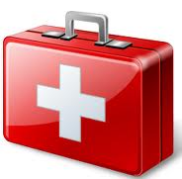
Recommendations
Consider actively pursuing other targets
If SHIL cannot demonstrate reduced ENT referral there is still a market for the product within A&E, just a more niche subset of patients, which may be more difficult to justify at existing price
SHIL could consider more actively promoting Rhinopinch across other targets which were highlighted in the research:
First aid kits for schools: children prone to spontaneous epistaxis that can usually be stopped by pinching alone
First aid kits for sporting events: trauma cases
Pharmacies for home use: especially for patients who suffer from recurrent epistaxis due to underlying conditions
If Rhinopinch is to be marketed outside of the medical profession, branding may need to be reconsidered. “Rhinopinch” is considered appropriate for medical staff and ties nicely into ‘Rapid Rhino’ branding, however HCPs feel there may be a need to include “nose pinch” or “nasal pinch” to packing for clarity, as not the non-medical will not associate “Rhino” with nose

Slide 40
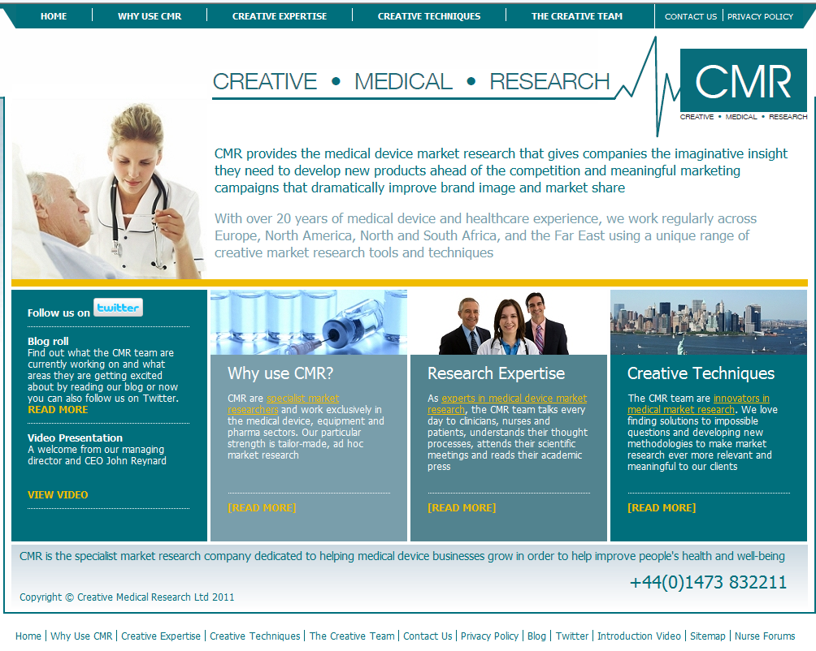
Contact Us
Lucy Davies
lucy.davies@creativemedicalresearch.com
George Ashford
george.ashford@creativemedicalresearch.com
Creative Medical Research Ltd 9 Pegasus Orion Business Court Great Blakenham Ipswich IP6 0LW United Kingdom
Tel: +44 (0) 1473 832211
www.creativemedicalresearch.com

